Slide 1
Battle of Neighborhood's
Unemployment Data Analysis-Gauteng Province South Africa
By Zaheer Abbas
Presentation made under IBM’s Professional Data Science Certification Coursera Capstone Project .

Slide 2
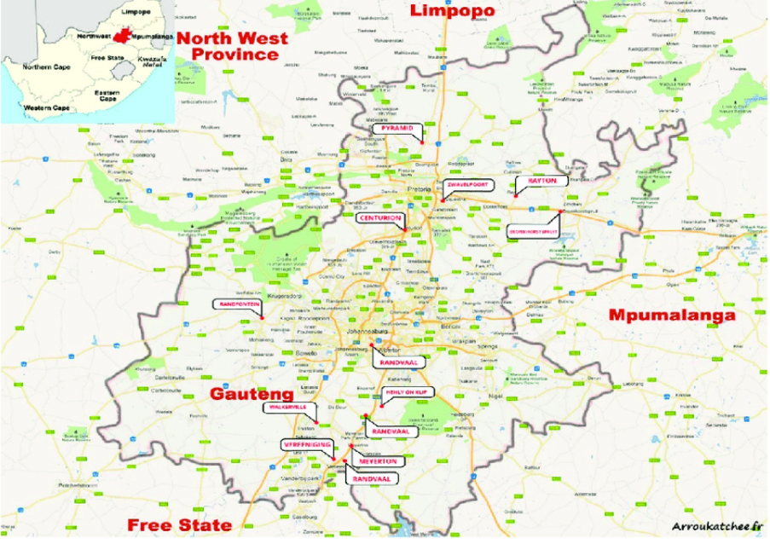
Business Problem
1-Introduction
The name Gauteng is derived from the Sotho name, gauta meaning "gold" with the locative suffix -There was a thriving gold industry in the province following the 1886 discovery of gold in Johannesburg. In Sesotho, the name Gauteng was used for Johannesburg and surrounding areas long before it was adopted in 1994 as the official name of a province.
Gauteng is smallest in area but most populated and Commercially bussiest province of South Africa.It is divided in 10 Muncipilities.
Unemployment rate of Youth in South Africa is continuously on rise (Highest in world i-e 26.6%) and causing huge frustration among youths.
Unemployment is the paint point and major matter of concern for current Govt.
We will analyse muncipility wise details of different factors to analyse the reason of unemployment in Youth
Youth Education Details
Geographical Distribution through Foursquare
Conclude Major factor from available Data
Provinces in South Africa

Slide 3
DATA
Data Collection:
We will use below reffernces for data
Gauteng Muncipility wise Youth Data downloaded from
https://youthexplorer.org.za/profiles/country-ZA-south-africa &
http://www.statssa.gov.za
Foursquare Developers Access to venue data: https://foursquare.com/
Data Utilization:
Downloaded data for Youth will be used to analyse Education, Unemployment distribution of youth among all municipalities of Gauteng Province.
Foursquare data will be used to explore the neighborhood facilities where different educated classes may be employed.
Data Cleaning:
Unnecessary columns like Education level of youth removed from Data.

Slide 4
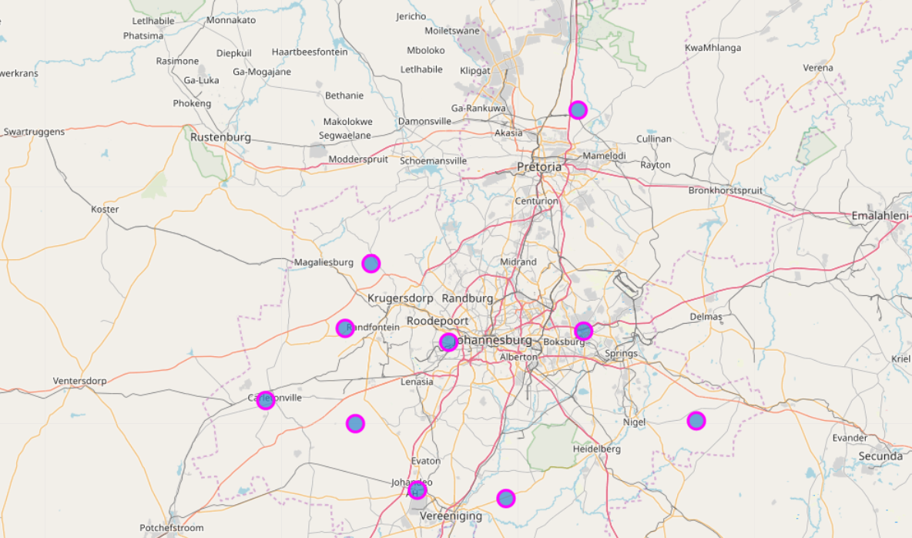
METHODOLOGY
Muncipilities in Gauteng
Explore Employed, Unemployed , Discouraged Work seekers , Economically Not active for all municipalities
Explore the neighbourhoods of all municipalities with foursquare area to find available opportunities/jobs for targeted youth.
Explore which municipalities have more opportunities for unemployed/Non active/Work seekers.

Slide 5
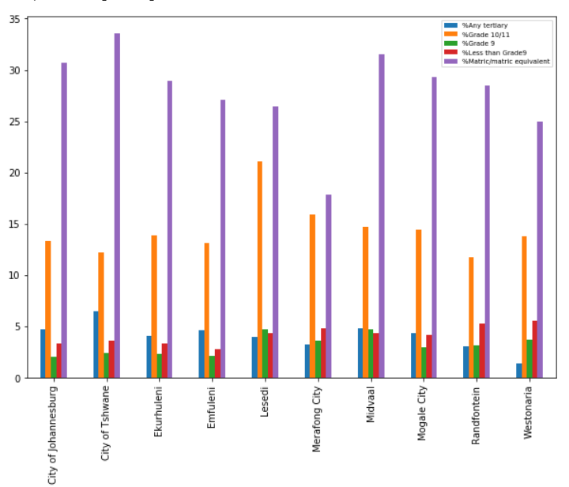
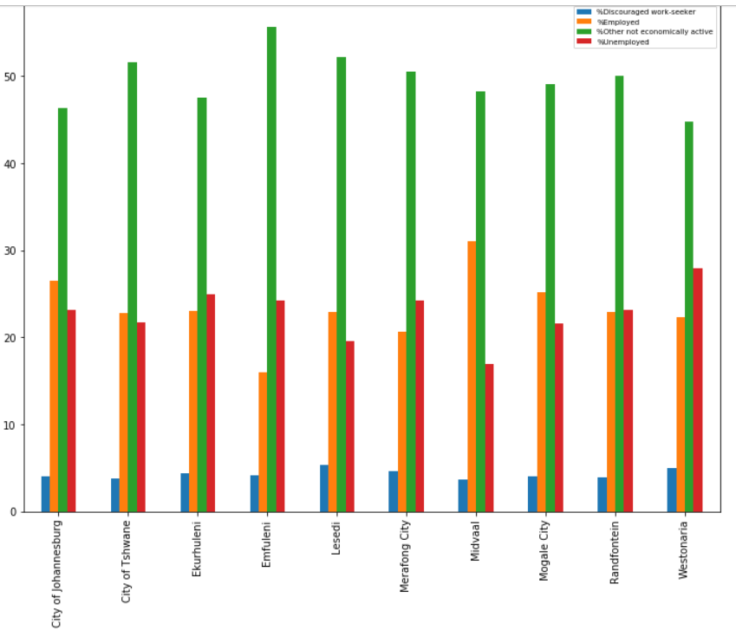
Data Exploration & OBSERVATIONS
It is quite obvious that overall ratio of 'Economically not active' is highest in all Muncipilities.
Muncipilities Emufuleni and Merafong City have the highest ratio of 'Unemployed'+'Economically not active' youth.
Muncipility Merafong City has the lowest ratio of Matric,Grade 10,11 equivalent.
Major Cities like Johannesburg,Tashwane(Includign Pretoria,Centurion) have high ratio of educated class above Matric within 2 KM distance.

Slide 6

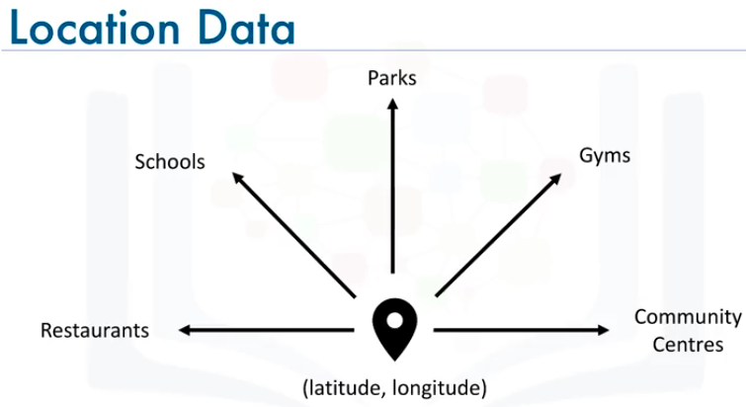
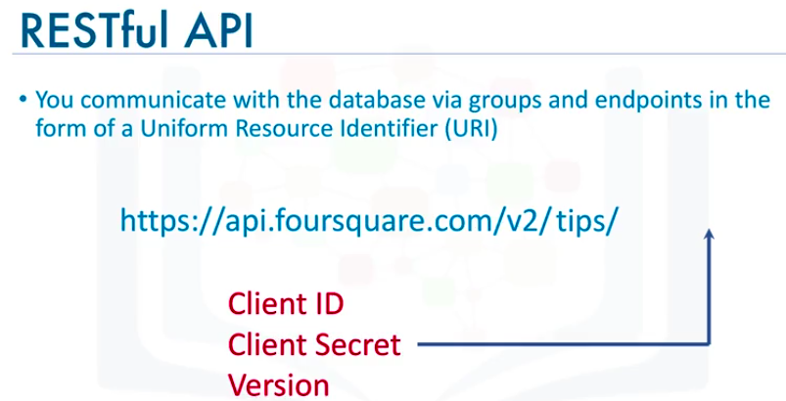
Location Data Provider – Foursquare
1
Location Data
Location data is data describing places and venues, such as their geographical location, their category, working hours, full address, and so on, such that for a given location given in the form of its geographical coordinates (or latitude and longitude values) one is able to determine what types of venues exist within a defined radius from that location.
2
Foursquare
Foursquare is a technologic company that built a massive dataset of accurate location data.
Foursquare powers location data for Apple, Uber, Snapchat, Twitter and many more.
Their API and location data is currently being used by over 100,000 developers.

Slide 7
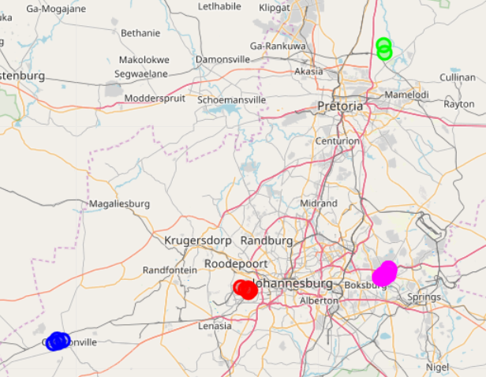
Neighbourhood Exploration with Foursquare API
Sr No | Muncipility | Munc_Latitude | Munc_Longitude | Venue | Venue_Lat | Venue_Long | Venue_Category
0 | City of Johannesburg | -26.214795 | 27.919478 | Lebo's Soweto Backpackers | -26.224562 | 27.913074 | Hostel
1 | City of Johannesburg | -26.214795 | 27.919478 | Orlando Stadium | -26.231817 | 27.922740 | Soccer Stadium
2 | City of Johannesburg | -26.214795 | 27.919478 | Jabu"s Snack Bar | -26.221035 | 27.921825 | Snack Place
3 | City of Johannesburg | -26.214795 | 27.919478 | Newcafe | -26.226791 | 27.927151 | Café
4 | City of Johannesburg | -26.214795 | 27.919478 | Meadow Point Chisa Nyama | -26.219329 | 27.900553 | Gastropub
5 | City of Tshwane | -25.593968 | 28.302789 | Vleise one | -25.586210 | 28.313360 | BBQ Joint
6 | City of Tshwane | -25.593968 | 28.302789 | Buffelsdrif bewarea | -25.605703 | 28.316634 | Nature Preserve
7 | Ekurhuleni | -26.184765 | 28.321073 | The Victorian Secret | -26.194625 | 28.305221 | Café
8 | Ekurhuleni | -26.184765 | 28.321073 | Grapes | -26.191536 | 28.303342 | Pub
9 | Ekurhuleni | -26.184765 | 28.321073 | Cafe Bellini | -26.192910 | 28.303454 | Café
10 | Ekurhuleni | -26.184765 | 28.321073 | Woolworths | -26.185365 | 28.317432 | Grocery Store
11 | Ekurhuleni | -26.184765 | 28.321073 | Bimbos | -26.174085 | 28.330680 | Fast Food Restaurant
12 | Ekurhuleni | -26.184765 | 28.321073 | Nando's | -26.170652 | 28.329398 | Portuguese Restaurant
13 | Ekurhuleni | -26.184765 | 28.321073 | Wimpy | -26.184646 | 28.315929 | Burger Joint
14 | Ekurhuleni | -26.184765 | 28.321073 | Ocean Basket Lakeside Mall | -26.184364 | 28.316081 | Seafood Restaurant
15 | Ekurhuleni | -26.184765 | 28.321073 | Nando's Benoni Lake | -26.184951 | 28.315312 | Portuguese Restaurant
16 | Ekurhuleni | -26.184765 | 28.321073 | Santa Rio Spur | -26.185365 | 28.313785 | Breakfast Spot
17 | Ekurhuleni | -26.184765 | 28.321073 | KFC | -26.169690 | 28.329003 | Fast Food Restaurant
18 | Ekurhuleni | -26.184765 | 28.321073 | Lemongrass - Dutch Indonesian Cuisine | -26.194854 | 28.304844 | Indonesian Restaurant
19 | Ekurhuleni | -26.184765 | 28.321073 | LegalWise Benoni | -26.186603 | 28.317528 | Lawyer
20 | Ekurhuleni | -26.184765 | 28.321073 | Virgin Active Benoni | -26.185305 | 28.325546 | Gym / Fitness Center
21 | Ekurhuleni | -26.184765 | 28.321073 | Northmead Mall | -26.172608 | 28.330456 | Shopping Mall
22 | Ekurhuleni | -26.184765 | 28.321073 | Checkers Hyper | -26.186365 | 28.326946 | Department Store
23 | Ekurhuleni | -26.184765 | 28.321073 | Edgars, Lakeside Mall | -26.185506 | 28.314959 | Clothing Store
24 | Ekurhuleni | -26.184765 | 28.321073 | Telkom Lakeside Mall Express | -26.185083 | 28.314764 | Mobile Phone Shop
25 | Ekurhuleni | -26.184765 | 28.321073 | Panarottis Lakeside Mall | -26.185172 | 28.313999 | Italian Restaurant
26 | Ekurhuleni | -26.184765 | 28.321073 | McDonald's | -26.184605 | 28.311827 | Fast Food Restaurant
27 | Ekurhuleni | -26.184765 | 28.321073 | Willowmoore Park | -26.194903 | 28.317671 | Athletics & Sports
28 | Ekurhuleni | -26.184765 | 28.321073 | Sasol Northmead | -26.174772 | 28.330113 | Gas Station
29 | Ekurhuleni | -26.184765 | 28.321073 | Jo's Grill | -26.173137 | 28.331355 | Fried Chicken Joint
30 | Ekurhuleni | -26.184765 | 28.321073 | Benoni Railway Station | -26.197928 | 28.310308 | Train Station
31 | Ekurhuleni | -26.184765 | 28.321073 | Roman's Pizza | -26.169069 | 28.328188 | Pizza Place
32 | Merafong City | -26.369370 | 27.374104 | Cassablancas | -26.363404 | 27.368639 | Restaurant
33 | Merafong City | -26.369370 | 27.374104 | Snowy Lane | -26.358223 | 27.382915 | Pizza Place
34 | Merafong City | -26.369370 | 27.374104 | Fiddler's Elbow Pub & Bistro | -26.355589 | 27.367612 | Pub
35 | Merafong City | -26.369370 | 27.374104 | Blyvooruitzicht Golf Club | -26.364803 | 27.355270 | Golf Course
Top-4 Muncipilities have different venues within 2 KM distance,so we will restrict to only these 4 for further working

Slide 8
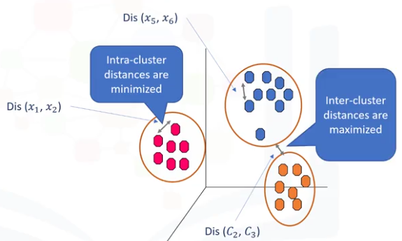
K- Means Clustering (Unsupervised Machine Learning Algorithm)
Unsupervised Learning
Supervise, means to observe, and direct the execution of a task, project, or activity. We do not supervise the model, but we let the model work on its own to discover information that may not be visible to the human eye. It means, the unsupervised algorithm trains on the dataset, and draws conclusions on unlabeled data.
What is a Cluster?
K-Means Clustering
1
A cluster is a group of data points or objects in a dataset that are similar to other objects in the group, and dissimilar to datapoints in other clusters.
2
K-Means is a type of partitioning clustering, that is, it divides the data into K non-overlapping subsets or clusters without any cluster internal structure or labels. This means, it's an unsupervised algorithm.

Slide 9
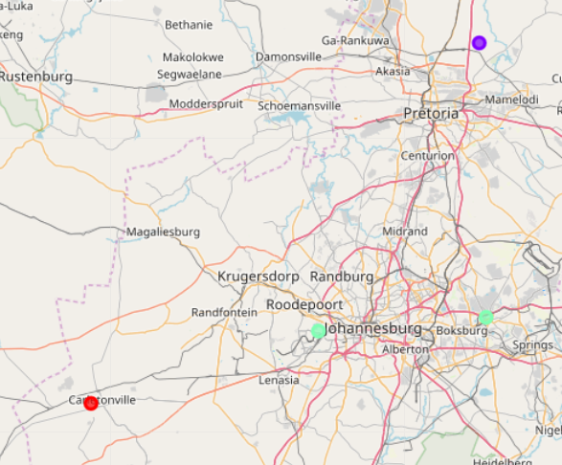
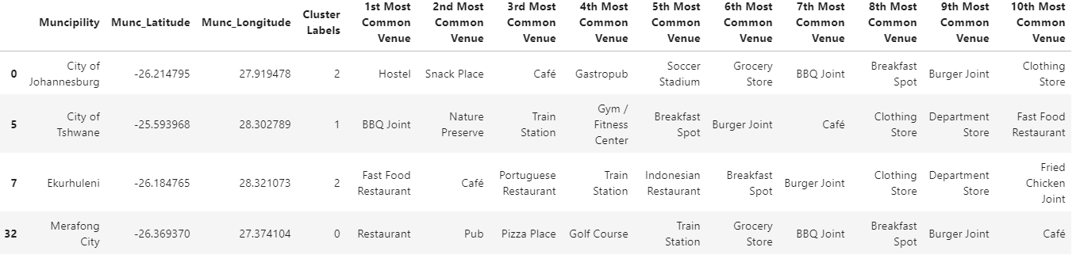
Result:K Mean Clustering-Top-4 Muncipilities
Municipalities have been divided in 3 clusters.
City of Johannesburg and Ekurhuleni have most opportunities for Employment

Slide 10
Discussions and Recommendations
1
In the Foursquare API, we have queried the Venues of a locality by specifying the LIMIT and Radius of our choice. We have chosen less LIMIT as the number of API calls that can be done using a free account in Four Square are less.
○ We can increase the limit for more accurate results.
○ We can increase the Radius for more venue results from each city
2
In the venue categories we are choosing only few out of 2000 that are available to give weights and identify the best cluster. Hence, assigning weights must be done relatively for each category and then considering more number of venue categories would actually yield a better output.

